Slide 1
Employee Data Analysis using Excel
STUDENT NAME: Keerthi.S
REGISTER NO: 312211169
DEPARTMENT: B.com Bank management
COLLEGE : Dr.M.G.R.Janaki arts and science college for women

Slide 2
PROJECT TITLE
Employee Performance Analysis using Excel

Slide 3


AGENDA
Problem Statement
Project Overview
End Users
Our Solution and Proposition
Dataset Description
Modelling Approach
Results and Discussion
Conclusion
3/21/2024 Annual Review

Slide 4

PROBLEM STATEMENT
The employee data analysis is done in order track the employee's performance for the betterment of the company.

Slide 5

PROJECT OVERVIEW
Analysing the performance of the employee by considering various factors like Gender, performance score, ratings, achievements ect., is called employee data analysis.

Slide 6

WHO ARE THE END USERS?
CEO
MANAGER
ASSISTANT MANAGER
REGULAR EMPLOYEES

Slide 7
OUR SOLUTION AND ITS VALUE PROPOSITION
Conditional formatting - missing
Filter - remove
Formula - performance
Pivot - summary
Graph - data visualization

Slide 8
Dataset Description
Employee=- kaggle
26- features
9 - features
Emp id-num
Name-text
Emp type
Performance level
Gender- male female
Employee rating -num

Slide 9
THE "WOW" IN OUR SOLUTION
Performance level =IFS(Z8>=5, "VERY HIGH", Z8>=4,
“HIGH", Z8>=3, "MED", TRUE, "LOW")
3/21/2024 Annual Review
‹#›

Slide 10
MODELLING
Data collection
From kaggle
From edunet dashboard
Feature collection
Data cleaning
Identified missing values
Filtered out the missing values
Performance level calculation
Through attendance
Ratings
Pivot table
Graph
Visualization
‹#›

Slide 11
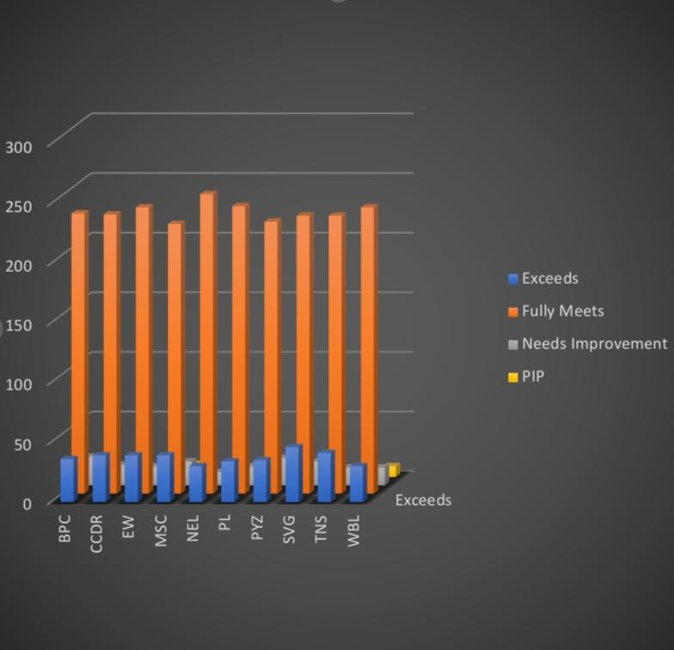
RESULTS
‹#›

Slide 12
conclusion
By comparing the performance of the employee's
Number of employees performaning average are higher in
number and so we should motivate them to do better.
As the graph shows employees who perform well are very
low in number here.
we should motivate the employee's by giving out tasked
based on there performance to get better output.

